Slide 1

Software Engineering The Software Process(Spiral&CMMI)
Slides for cse470 video lecture series produced by:
A.M.Esfar-E-Alam
Afrina Khatun
Dr.Muhammad Zavid Parvez

Slide 2

Spiral Model
Rarely Used but an important model
Its a model that works for projects with unlimited budget, time and projects that has huge risk factors.
Example, making a heavy lift system for space shuttle and international space station.
Another example can be about a company name Galaxy inc.

Slide 3
They wanted to send 6 dozens satellite in space and build a satellite based cellular system.
So that remote places like even in Antarctica where you don’t have any BTS(mobile tower) you can still be able to communicate using your cell.
You are never out of network.
As you can see for this project:
Risk were enormous
Needs a huge budget
No published materials or experienced worker
Risks will be coming and identified once the project kicks off
Several million codes had to be written and you don’t even have Stackoverflow…

Slide 4
Spiral Model Formal Definition
The spiral model is a risk-driven process model generator for software projects. Based on the unique risk patterns of a given project, the spiral model guides a team to adopt elements of one or more process models, such as incremental, waterfall, or evolutionary prototyping.
This model was first described by Barry Boehm in his 1986 paper "A Spiral Model of Software Development and Enhancement".

Slide 5
Spiral model sectors
Objective setting
• Specific objectives for the phase are identified
Risk assessment and reduction
• Risks are assessed and activities put in place to reduce key risks
Development and validation
• A development model for the system is chosen which can be any of the generic models
Planning
• The project is reviewed and next phase of the spiral is planned

Slide 6
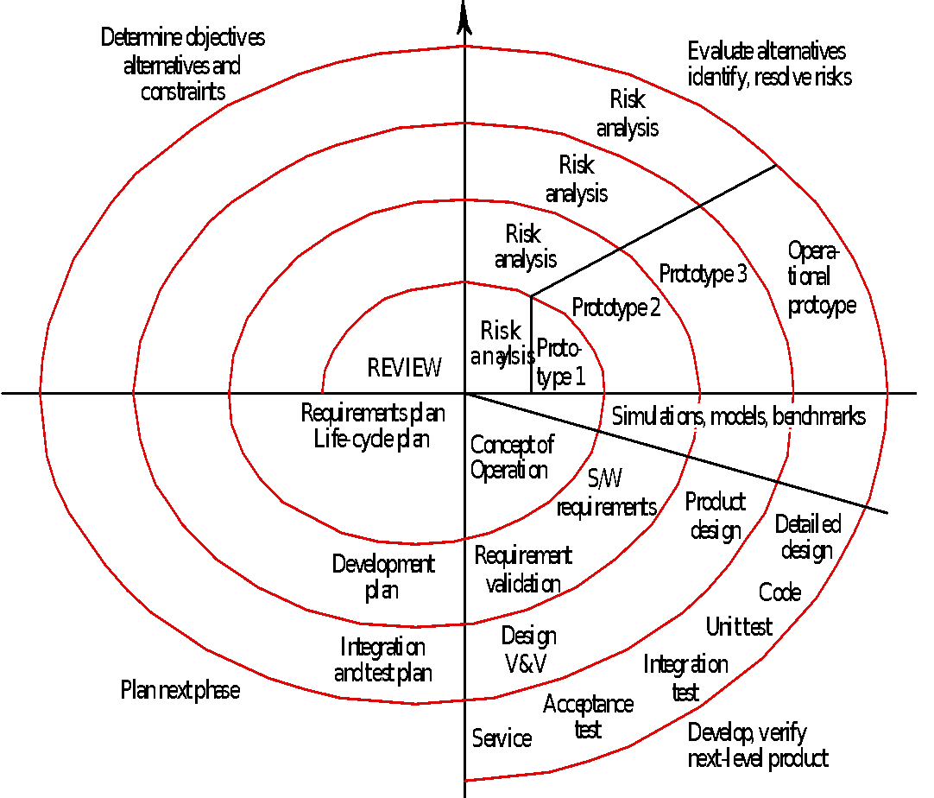
Spiral model Figure
Here is the image depicting spiral model.
As you can see spiral loops showing phase by phase development.
You can see we are doing risk analysis in every phase, planning and keep building prototype until we reach our goal.

Slide 7
Spiral model usage
Spiral model has been very influential in helping people to think about iteration in software processes and introducing the risk-driven approach to development. In practice, however as mentioned, the model is rarely used as published for practical software development.
So if you are a project manager or lead developer when would you suggest spiral model? It is if you have:
Long term project commitment and budget
Users and developers unsure of the needs
Requirements are complex
New product line
Significant changes are expected(research and explanation)

Slide 8
CMMI
The Capability Maturity Model Integration (CMMI) is a process and behavioral model that helps organizations streamline process improvement and encourage productive, efficient behaviors that decrease risks in software, product and service development.
It is developed by CMU
This process is mostly a requirement if you want to get a contract for software development in US govt organization.
In this model work is divided in such a way so that you have different maturity level of a system you are building.
It divided in 5 maturity level and you need to improve the system until you reach level 5

Slide 9
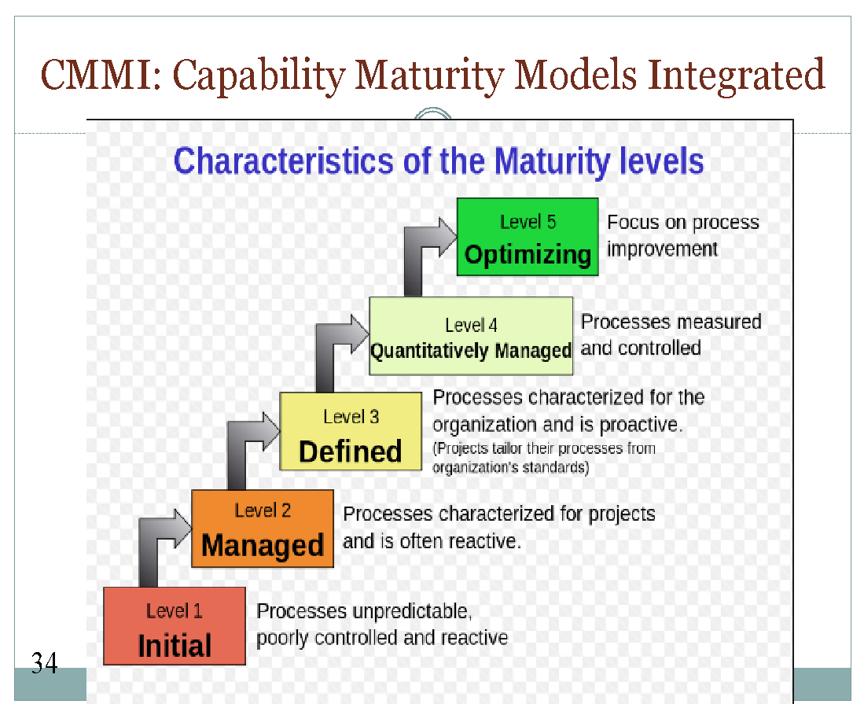
Once you reach level 5 that does not mean the end of your system.
It means now the system is full proof, it just need regular maintenance nothing else.

Slide 10
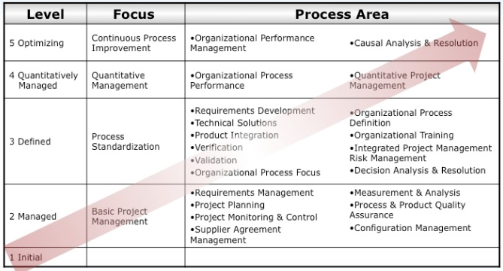
Pause and go through this chart that will give you detailed Idea of what happens in each maturity levels

